Slide 1


Document Sharing Across Network Topologies
IHE ITI White Paper
Presented by Spencer LaGesse
6 March 2023
Notes:
Hello, my name is Spencer LaGesse, and I am a member of the IHE IT Infrastructure Technical Committee. Today, I am going to tell you about the Document Sharing Across Network Topologies White Paper. I will explain the purpose of the white paper, the interoperability use cases addressed by it, and how it uses the Mobile Care Services Discovery integration profile as the basis of recommended document sharing network directory architectures.

Slide 2
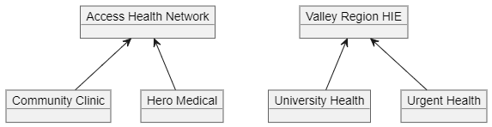
Emergence of Document Sharing Networks
Support single jurisdictions and purposes
Networks tend to start small; grow larger
Eventually want to join
No
Connectivity
Existing Resources:
XDS.b Integration Profile
XCA Integration Profile
MHD Integration Profile
Enabling Document Sharing Health Information Exchange Using IHE Profiles White Paper
Notes:
IHE has a long history of developing integration profiles and supporting materials that help Healthcare IT architects construct document sharing ecosystems. The XDS family of integration profiles and the Enabling Document Sharing Health Information Exchange Using IHE Profiles White Paper provide guidance that healthcare communities can use to enable community wide and cross community document sharing. However, many of the document sharing networks that have emerged were originally designed with a limited scope, supporting only single jurisdictions or exchange purposes. These networks have grown over time, but members of different networks remained unable to exchange information with one another. This results in a common desire for multiple networks to become interconnected, allowing the members of both networks to communicate amongst one another.

Slide 3
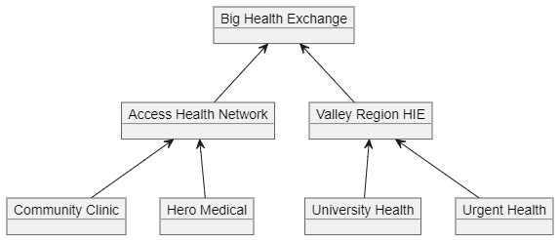
Networks of Networks
Different networks become interconnected
Directories must be combined
Access agreements must be reconciled
May result in intermediaries
Notes:
When different networks choose to become interconnected, they form a multi-layered network, or a Network of Networks. The newly formed network is often developed and administered by a separate Organization from the members of each of the original networks . This results in several technical challenges that must be overcome for the interconnection to be successful.
Members of each network must be able to discover one another, meaning the directories for both networks must be combined.
In addition, the authentication and authorization policies of each network must be reconciled. This often results in intermediary systems that must mediate the access requirements of both networks, and these intermediaries might also provide health data aggregation services.
This amounts to a technical challenge that must be successfully navigated jointly by all the stakeholders in each of the networks.

Slide 4
Document Sharing Across Topologies
Expands upon HIE White Paper For Multi-Layered Networks
Discusses topology that emerges when combining networks
Recommends directory structure for communicating connectivity
Mobile Care Services Discovery (mCSD) used for basis of FHIR directory structure
Notes:
The Document Sharing Across Topologies White Paper aims to help network architects navigate the technical challenges introduced by the creation of large multi-layered networks. It does so by expanding upon the previous Enabling Document Sharing Health Information Exchange Using IHE Profiles white paper to explain how different document sharing communities might combine their networks into a larger, multi-layered document sharing network. When this happens, a more complex network topology emerges, and it is often necessary to represent the network in a centralized directory so that members can discover one another. This white paper recommends a FHIR directory structure that satisfies this need, based on the Mobile Care Services Discovery Integration Profile.

Slide 5
Document Access Use Case
Patient recently moved from across the country; PCP needs access to medical record
How can an EMR discover the existence of outside organizations it does not have a direct trust relationship with?
How can a route to request information from that organization be discovered?
How can an EMR discretely correlate the received documents by authoring organization?
How can they be associated with the list of organizations in the organization directory that end users have access to?
Notes:
There are two primary use cases that this white paper aims to address. The first is a document access use case, where an end user needs access to a patient’s medical record stored elsewhere. When a patient moves and needs to switch to a healthcare system in a different geographic area, their new primary care provider will want to be able to find and review their medical history so that they can provide proper continuity of care. When the patient doesn’t recall all the details of their past care providers, it can be challenging to find all their records in a large exchange network. The Document Access use case attempts to explain how this need can be addressed in a multi-layered network by answering critical questions such as:
How can an EMR discover the existence of outside organizations with which it does not have a direct trust relationship?
How can a route to request information from that organization be discovered?
How can an EMR discretely correlate the received documents by authoring organization?
and
How can those documents be associated with the list of organizations in the directory that end users have access to?

Slide 6
Push Use Case
Referral to specialist in a different jurisdiction
How can an EMR discover the message transmission route to send a message to a recipient at an outside organization with which it does not have a direct trust relationship?
How can a pushed message be addressed to an individual or organization within a community?
Notes:
The second use case presented in the paper is a push use case, where a patient needs to be referred to a distant healthcare provider for specialized care. Again, being a part of a large, multi-layered network can present discovery and routing challenges. The white paper attempts to address these challenges by addressing questions such as
How can an EMR discover the message transmission route to send a message to a recipient at an outside organization with which it does not have a direct trust relationship?
and
How can a pushed message be addressed to an individual or organization within a document sharing community?

Slide 7
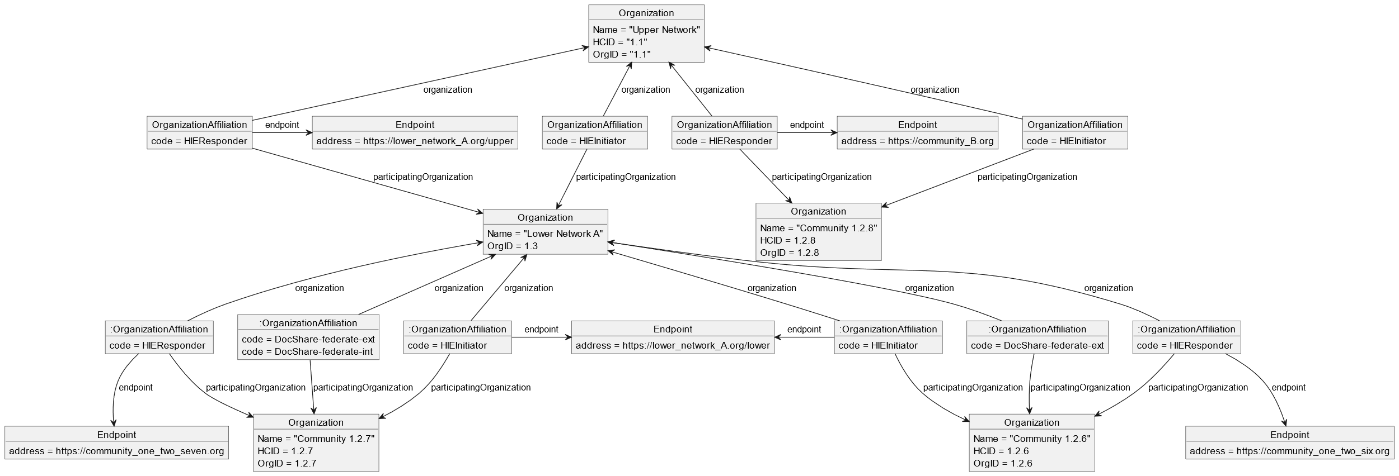
mCSD As An Endpoint Directory
Multiple Hierarchy Functionality
Use of FHIR Organization, OrganizationAffiliation, Endpoint Resources
Notes:
As previously discussed, the Mobile Care Services Discovery IHE Implementation Guide provides the basis of the FHIR Directory structure recommendation presented in the paper. mCSD’s strength lies in its profiling of the FHIR OrganizationAffiliation Resource to enable the representation of multiple organizational hierarchies. This allows for discrete representation of multiple types of relationships between Organizations, meaning information about multiple document sharing networks can co-exist with information about other hierarchical relationships between the network members.
Ultimately the Organization, OrganizationAffiliation, and Endpoint FHIR Resources are profiled to provide a mechanism for structuring the directory in a way that solves the technical challenges needed to address the previously mentioned use cases.

Slide 8
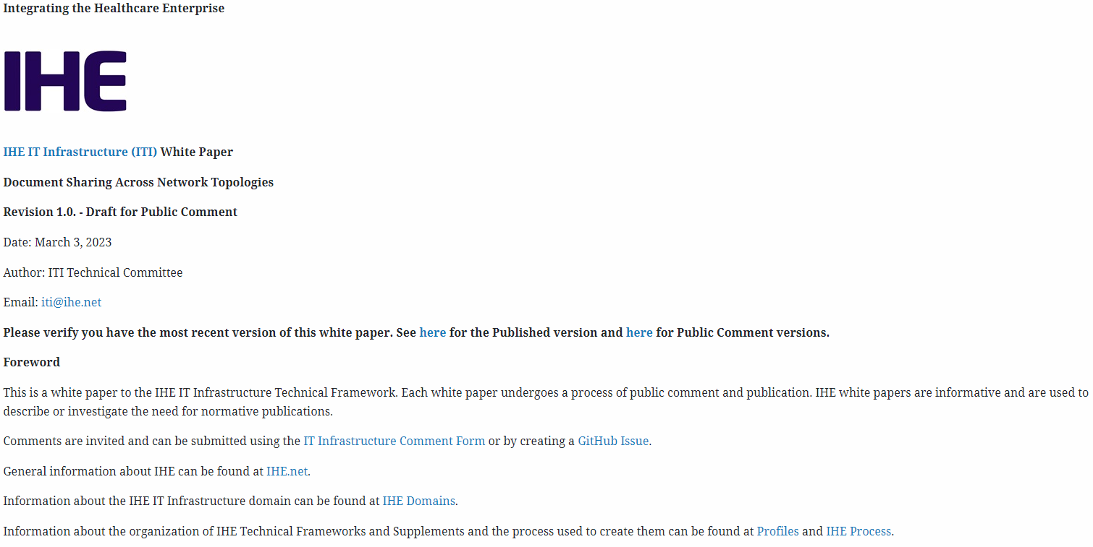
Document Sharing Across Network Topologies White Paper
Public Comment 3 March 2023-3 April 2023
https://profiles.ihe.net/ITI/papers/Topologies/index.html
Notes:
Thank you for your time in learning about this new white paper. We are currently in a public comment period through April 3rd, 2023. We are happy to receive your feedback, and we hope that you will find the paper useful in navigating the construction of large document sharing networks.

